Slide 1
Teach me to help
MODULE II Lesson 3
Verbal and content communication techniques to be used with people with disabilities in the online environment - content creation
Project no: 2022-1-RO01-KA220-VET-000085029

Slide 2
Introduction
MODULE 2 Lesson 3 - Verbal and content communication techniques to be used with people with disabilities in the online environment - content creation
The lesson is structured to provide a comprehensive understanding of the online verbal and non-verbal communication process. We begin by unraveling the essence of online communication, exploring its various modes and methods. Understanding the significance of online communication for individuals with disabilities and recognizing the challenges they encounter is pivotal in creating an inclusive learning environment. We navigate through three fundamental categories of online course communication (oral, written, non-verbal), shedding light on effective strategies tailored for digital learning spaces and different types of disabilities.

Slide 3
Introduction
Additionally, real-world examples and case studies are woven into the lesson, showcasing successful implementations of communication techniques. Case studies such as "Supporting people with autism spectrum disorder in online discussions" and "Inclusive Online Learning Environment for Support Services" highlight the practical application of these strategies.
By the end of this module, you will grasp the nuances of online verbal and non-verbal communication and gain valuable insights into creating an inclusive digital learning atmosphere and content for people with disabilities.

Slide 4
Content
01
Verbal and Non-verbal Communication Essentials
Building Blocks for Accessible Online Communication
Verbal Communication Techniques in Online Education
Creating Accessible Content: 3 Strategies for Inclusivity
Tailoring Verbal and Content Communication
Conclusion
Useful links
02
03
04
05
06
07

Slide 5
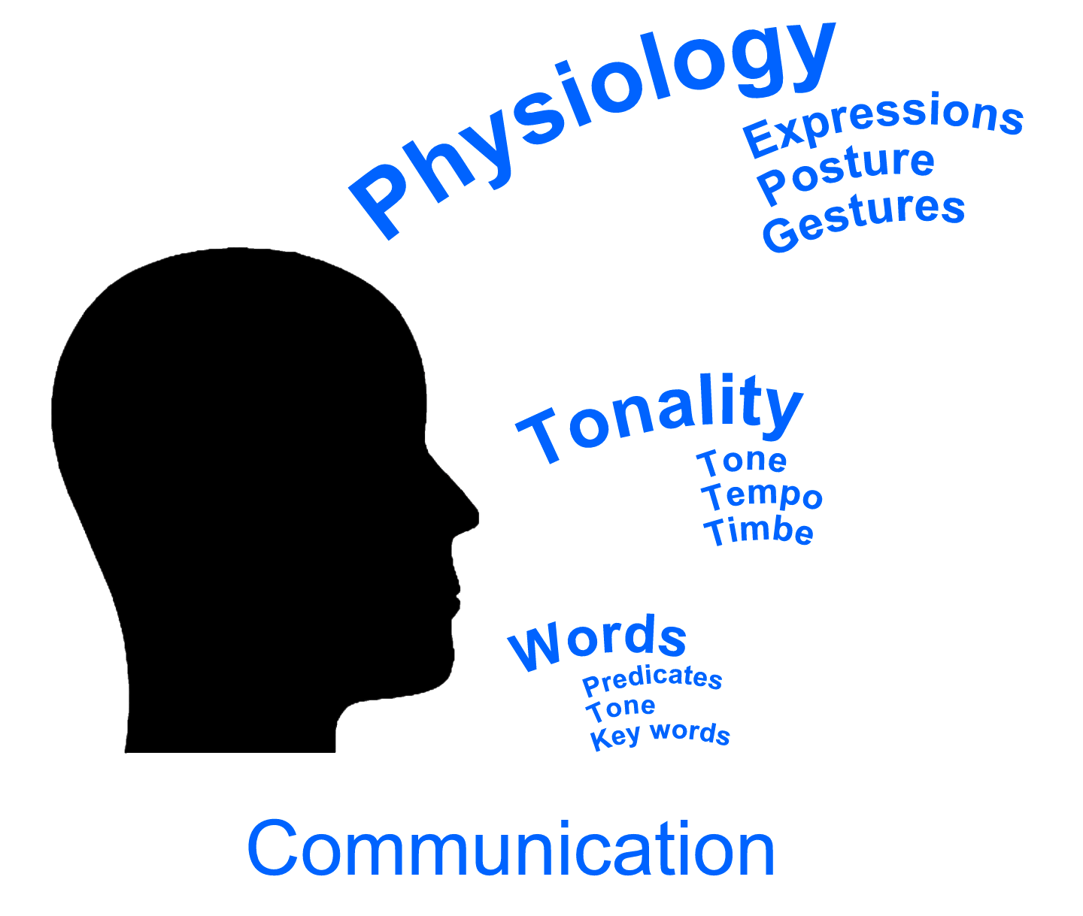
Lesson Objectives
At the end of the lesson, participants will be able to:
Define and argue the importance of online communication in virtual education for people with disabilities
Identify key elements of verbal and non-verbal communication in the online environment.
Apply effective communication techniques to enhance the online learning experience for people with disabilities.
Create online materials with accessible and inclusive content.
Adapt their communication style to different environments and to the needs of people with different disabilities.
Overcome barriers in online communication with people with disabilities.

Slide 6
01
Verbal and Non-verbal Communication Essentials
Definition, importance and communication process

Slide 7
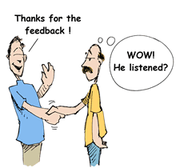
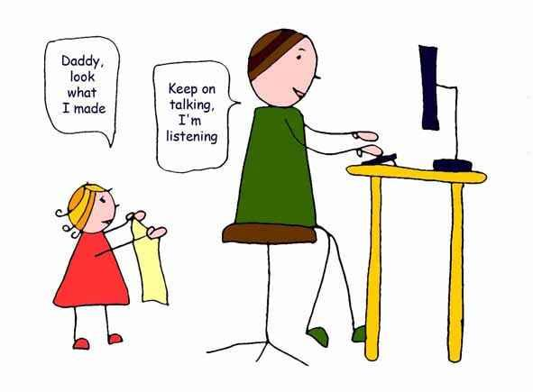
Verbal and non-verbal communication essentials
Communication is the art of transmitting information, ideas, attitudes and feelings from one person to another. It is a process of meaningful interaction among human beings.
Today, it is more than “Talk the Talk.” You have to “Walk the Talk.”
How to ensure you are not interrupted
How to create trust and rapport
How to deal with rude and aggressive people in a manner that is professional
How to trigger positive responses in others

Slide 8
Axioms of communication
Communication is irreversible: the message sent and received cannot be taken back.
Communication is inevitable, non-communication is impossible.
Communication involves processes of accommodation and adjustment of behaviors.
Continuous process. Dialogue is continuous. Because each of us is both sender and receiver at the same time, you can never be sure who started or who continued the communication.
Communication develops on two levels:
content level: the information itself (numbers, data, words)
relationship level: the purpose of the information (emotions, attitudes, gestures, voice)

Slide 9
Scheme of communication
Feedback to the sender
Message decoded
Idea
Message
sent
Message received
Coding
Decoding
Internal factors
Internal factors
External barriers
Possible feedback transmitted to the receiver
Posibil feedback transmis receptorului
PAGE
22

Slide 10
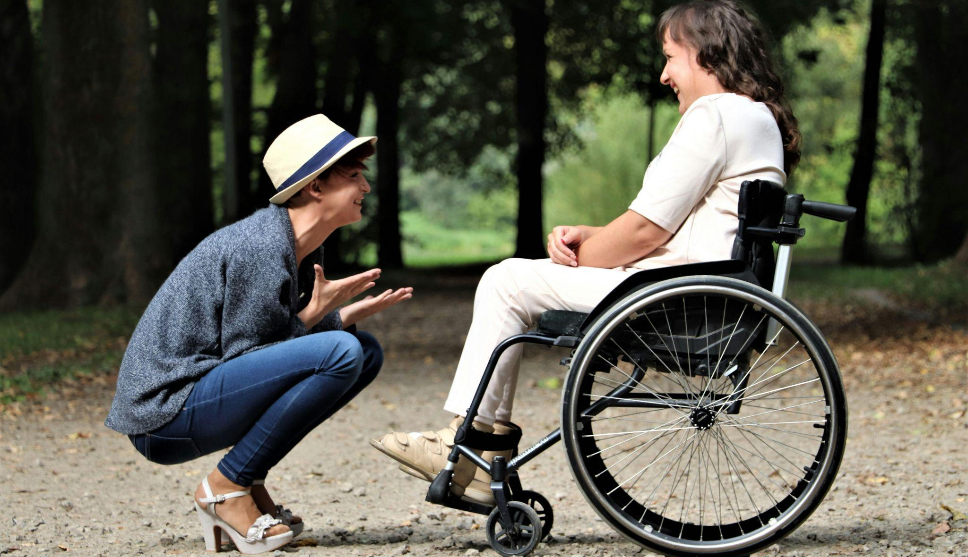
Verbal & nonverbal communication
With verbal communication, people express their thoughts, ideas, and feelings through spoken or written language.
Nonverbal communication uses other methods, such as body language including facial expressions, gestures, and other body movements.

Slide 11
Verbal & nonverbal communication
Verbal | Nonverbal
Oral – spoken words/content Face-to-face Telephone Internet | Eye contact (oculesics), body language (kinesics), social distance (proxemics), touch (haptics), voice (paralanguage), physical environment, appearance, and use of objects.
Written – signs and symbols Emails Letters Reports, memos | Paralanguage: voice quality, rate, pitch, loudness, and speaking style (laughter, coughing, screaming, pausing, accent etc.) tone, inflection, emphasis
 | Conscious and unconscious processes of encoding and decoding

Slide 12
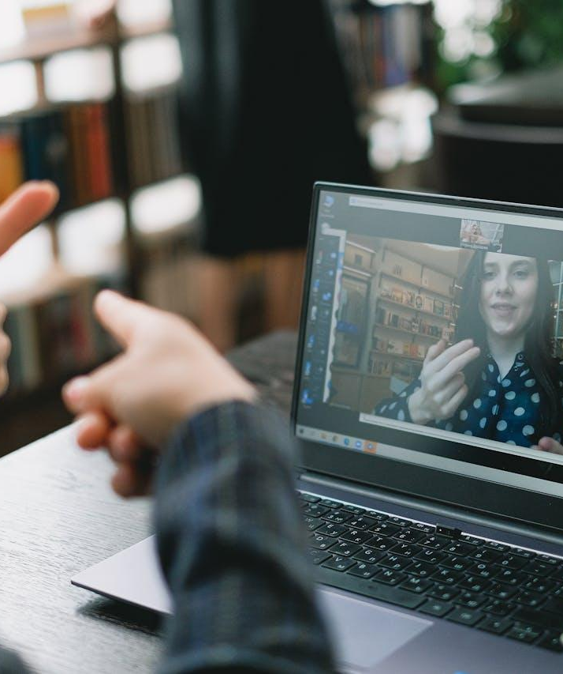
Nonverbal communication: Sign language
Sign language is a natural and visual form of language that uses movements and expression to convey meaning between people.
It uses any means of communication through bodily movements, when spoken communication is impossible or not desirable. It is based on visual cues through the hands, eyes, face, mouth, and body. The gestures or symbols in sign language are organized in a linguistic way. However, sign language is not a mimed version of spoken language. It is a separate language that occasionally uses characteristics of spoken language.
Sign language is not universal; people who are deaf from different countries speak different sign languages. Even though sign languages are different from one country or region to another, Deaf people from different countries are able to communicate with each other, at least at a basic level.
(Source: Sign Language Dictionary https://dlmg.ro/en/romanian-sign-language/ )

Slide 13
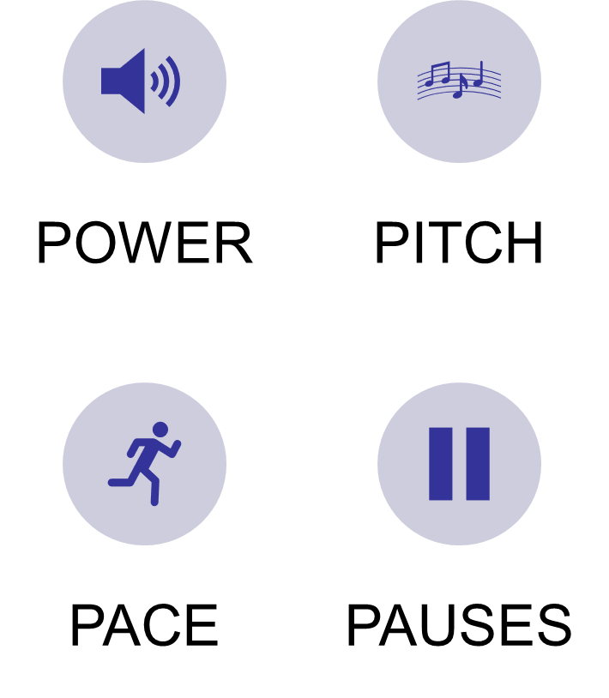
Voice Dynamics: Use the Four Ps

Slide 14
Verbal communication
Rules of verbal communication
Who am I addressing?
What do I want to communicate?
How do I want to communicate it?
What language will I use?
Word choice is important for the listener's understanding of the message, message retention and triggering the desired action.
Speak in the language of your listeners.
Use clear, descriptive and specific words.
K.I.S.S. (Keep It Short and Simple / Keep it Simple and Straightforward)
Smile "can be heard" and "can be read".
Read more https://changingminds.org/techniques/language/persuasive/keep_it_simple.htm

Slide 15
Written language vs. Speech
Writing is usually permanent and written texts cannot usually be changed once they have been printed/written out. | Speech is usually transient, unless recorded, and speakers can correct themselves and change their utterances as they go along
Written language tends to be more complex than speech with longer sentences and many subordinate clauses. The punctuation and layout of written texts also have no spoken equivalent. | Spoken language tends to be full of repetitions, incomplete sentences, corrections and interruptions, with the exception of formal speeches and other scripted forms of speech, such as news reports and scripts for plays and films.
Writers receive no immediate feedback from their readers, except in computer-based communication. They need to explain things clearly and unambiguously than in speech, except in written correspondence between people who know one another well. | Speech is usually a dynamic interaction between two or more people. Context and shared knowledge play a major role, so it is possible to leave much unsaid or indirectly implied.

Slide 16
02
Building Blocks for Accessible Online Communication
Definition, importance and communication process

Slide 17
Principles of Effective Communication in Online Learning
In the quick-evolving field of online education, fostering an inclusive learning environment is crucial. This is especially true for people with disabilities, where communication demands a nuanced approach emphasizing understanding, empathy, and collaboration. Effective communication not only bridges the gap between educators and their beneficiaries, but also establishes vital connections among professionals, families, and caregivers, forming the bedrock for informed decisions that shape a person's educational journey.

Slide 18
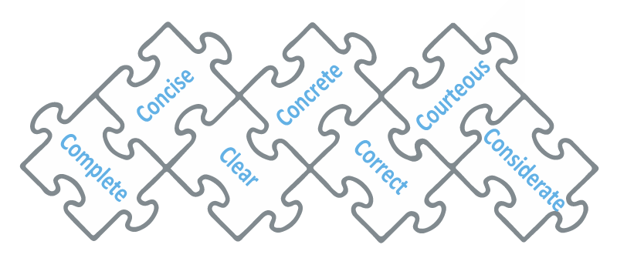
Principles of Effective Communication with people with disabilities in Online Learning
When interacting online with people with disabilities, clarity, timeliness, coherence, urgency, conciseness, correctness, courteousness, and completeness form the eight guiding principles.
We will approach these principles, exploring practical strategies and examples that exemplify how the principles of effective communication can be applied to online courses and communication with disabled people.
https://study.com/academy/lesson/communicating-with-and-about-people-with-disabilites.html

Slide 19
Principles of Effective Communication with people with disabilities in Online Learning
Clarity: When creating online courses and communicating with people with disabilities, use clear and concise language. Avoid using jargon or technical terms that your beneficiaries may not understand. Be sure to explain complex concepts in a simple and straightforward way.
Timeliness: Be timely. Respond to their questions and concerns in a timely manner. This will show your beneficiaries that you value their time and input.
Coherence: Make sure that the content is coherent and well-organized. Use headings and subheadings to break up the content and make it easy to navigate. Be sure to use transitions to connect the different ideas and concepts.
Urgency: Create a sense of urgency. This will encourage them to complete their assignments on time and to participate in class discussions. You can create a sense of urgency by setting deadlines, using countdowns, and offering incentives.

Slide 20
Principles of Effective Communication with people with disabilities in Online Learning
Conciseness: Be concise. Avoid using unnecessary words and phrases. Get to the point quickly and efficiently.
Correctness: Be grammatically correct. Proofread your messages carefully before sending them. This will show your people that you are professional and that you take your work seriously.
Courteousness: When communicating with people with disabilities, be courteous and respectful. Avoid using rude or insensitive language. Be mindful of the cultural differences and beliefs.
Completeness: Be complete. Provide all of the information that your beneficiaries need to be successful. If you are unsure about what information to include, ask for their feedback.
Find out more https://cxl.com/blog/basic-principles-of-communication/
https://www.seyens.com/7cs-effective-communication-science/

Slide 21
Types and Categories of Online Communication
By understanding the different types and categories of online communication, social care professionals can choose the most appropriate tools and strategies for their beneficiaries with disabilities. Online communication can be categorized in a number of ways, such as:
By medium: Text-based, audio, video, image, collaborative
By purpose:
Personal, professional, educational, social
By synchronicity: Synchronous (real-time) or asynchronous (non-real-time)

Slide 22
Types and Categories of Online Communication
By medium
Online communication is the exchange of information between people using computer networks. It can take many forms, including:
Text-based communication: Email, social media posts, instant messaging, discussion forums, chat rooms, blogs, wikis etc.
Audio (verbal) communication: Phone calls, voicemails, audio recordings, podcasts etc.
Video communication: Video chats, video conferencing, video recordings, live streaming etc.
Image communication: Sharing photos, graphics, and other images online.
Collaborative communication: Online tools for working together on projects, such as shared documents, spreadsheets, presentations, and whiteboards.

Slide 23
Types and Categories of Online Communication
By purpose
Online communication can be used for a variety of purposes, including:
Personal communication: staying in touch with friends and family, sharing news and photos, and making plans. Personal communication can help people to feel connected to their classmates and instructor.
Professional communication: collaborating with colleagues, communicating with clients, and marketing and promoting products and services. Professional communication can help people to develop the skills they need to succeed in their careers.
Educational communication: taking online courses, participating in discussion forums, and accessing educational resources. Educational communication is essential for people to learn and grow.
Social communication: connecting with people who share your interests, joining online communities, and participating in social movements. Social communication can help people to develop their social skills and to feel connected to a broader community.

Slide 24
Types and Categories of Online Communication
By synchronicity
Synchronous (Real-time) communication: is real-time communication, such as a live online class or lecture. Synchronous communication can be a good way to build relationships and to provide immediate feedback to people.
Asynchronous (Non-real-time) communication: is communication that does not happen in real time, watching a pre-recorded video or participating to a discussion forum post. Asynchronous communication can be a good option for people who need more time to process information or who cannot participate in synchronous sessions due to time zone differences or other commitments.

Slide 25
Types and Categories of Online Communication
Examples of synchronous online communication:
Live video chat: This can be used for one-on-one conversations, group meetings, or even large-scale online events.
Phone call: This is a classic form of synchronous communication, and it can be used for both personal and professional purposes.
VoIP call: Voice over Internet Protocol (VoIP) calls allow you to make phone calls over the internet, which can be more affordable and convenient than traditional phone calls.
Online lecture: A common way of delivering online courses.
Online meeting: Can be used for team meetings, counseling sessions.
Online game: Many online games allow players to communicate with each other in real time using chat, voice chat, or video chat.

Slide 26
Types and Categories of Online Communication
Other examples of synchronous online communication include:
Webinars: Webinars are live online presentations that can be used to share information, teach new skills, or promote products and services.
Live streaming: Live streaming allows you to broadcast video and audio to a live audience over the internet.
Virtual reality (VR) and augmented reality (AR) experiences: VR and AR experiences can be used to create immersive and interactive online experiences that allow users to communicate with each other in real time.

Slide 27
Types and Categories of Online Communication
Examples of asynchronous online communication:
Email: The disabled beneficiaries can communicate with instructors and peers via email to ask questions, discuss assignments, and share resources.
Social media posts: Instructors can use social media to share announcements, course updates, and other relevant information with their beneficiaries. The beneficiaries can also use social media to connect with each other and discuss the course material.
Instant messages: Instructors and their beneficiaries can use instant messaging to communicate in real time, but asynchronously. This can be useful for quick questions or discussions.
Discussion forum posts: Discussion forums are a great way to interact with each other and with the instructor. They can post questions, share ideas, and respond to each other's posts.
Blog posts: Instructors can use blogs to share their thoughts on the course material, provide additional resources, and answer to questions. The disabled beneficiaries can also use blogs to share their own thoughts and experiences related to the course.
Wiki entries: Wikis are a great way for people with disabilities to collaborate on assignments and projects. They can work together to create and edit wiki entries, which can then be shared with the class.

Slide 28
Types and Categories of Online Communication
In addition to these examples, MOOCs and other online courses often use a variety of other types of asynchronous online communication, creating a rich and engaging learning experience, such as:
Pre-recorded lectures: Instructors can pre-record lectures and then make them available to people to watch at their own pace.
Quizzes and exams: The beneficiaries can take quizzes and exams online at their own convenience.
Assignment submissions: The beneficiaries can submit assignments online to their instructor for evaluation.
Discussion boards: Discussion boards are similar to discussion forums, but they are often used for more specific purposes, such as discussing a particular lecture or assignment.
Group projects: The disabled people can collaborate on group projects online using a variety of tools, such as shared documents, spreadsheets, and presentations.

Slide 29
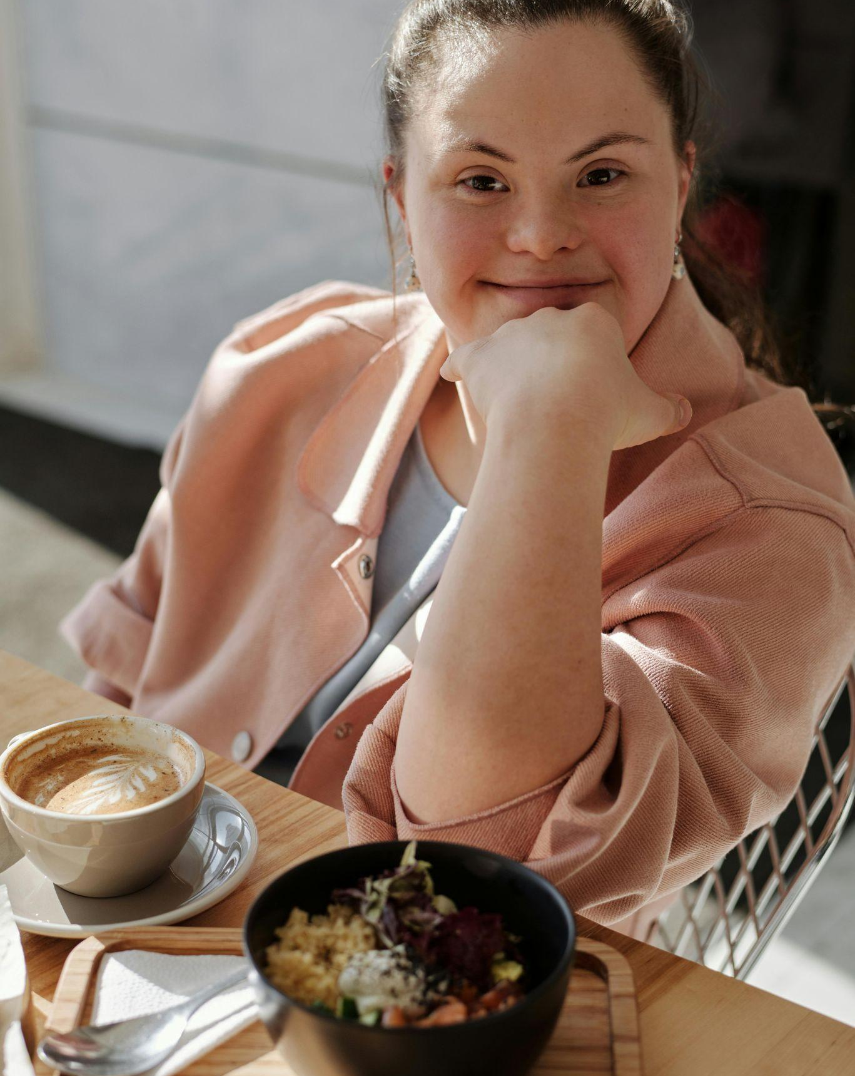
Types and Categories of Online Communication
The choice of communication type depends on several factors:
Course Objectives: Certain topics might be better explained through live lectures, while others might be suitable for discussion forums.
Learner Needs: Consider learner preferences, learning styles, and time constraints, incorporating a mix of synchronous and asynchronous methods for flexibility.
Technology: The online course platform should support the chosen communication methods.

Slide 30
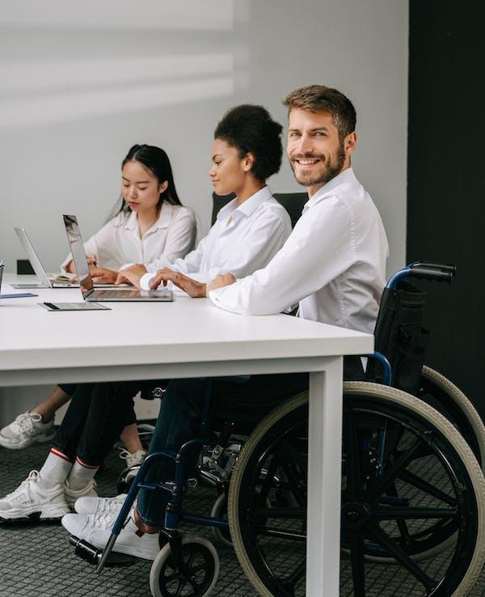
How can social care trainers use synchronous and asynchronous learning?
Social care trainers have the flexibility to employ both synchronous and asynchronous learning methods to enhance their teaching approaches.
They can utilize synchronous learning for real-time interactions such as live lectures, engaging discussions, and collaborative group projects, fostering immediate engagement and active participation. Simultaneously, asynchronous learning offers the advantage of providing people with on-demand access to pre-recorded lectures, essential readings, and various resources, catering to different learning paces and preferences.
Here are some specific examples of how social care trainers can use synchronous and asynchronous learning to teach adults with disabilities:

Slide 31
How can social care trainers use synchronous and asynchronous learning?
Synchronous learning:
Offer live online classes and lectures that are accessible to people with disabilities by providing captions and transcripts for videos and audio recordings.
Use chat rooms and polls to encourage people to interact with the content and with each other.
Provide people with the opportunity to meet with you one-on-one during office hours to ask questions and get help with assignments.
Asynchronous learning:
Provide people with access to pre-recorded lectures and readings that are accessible to people with disabilities by providing captions and transcripts for videos and audio recordings, and by providing alternative formats for text materials, such as large print and screen reader-friendly text.
Use discussion forums to encourage people to discuss the course material and to learn from each other.
Give people written assignments and other activities that they can complete at their own pace.
By combining synchronous and asynchronous learning techniques, trainers can create a dynamic learning environment that incorporates the benefits of both approaches.

Slide 32
Empowering Through Accessible Online Communication
Let’s observe the difficulties of the online communication and identify solutions
People with disabilities may face a variety of challenges when communicating online. These challenges can vary depending on the type of disability and the specific communication platform being used. Some common challenges include:
Accessibility: Some online content and platforms may not be accessible to people with disabilities. For example, websites that are not designed to be used with screen readers may be difficult or impossible for people who are blind or visually impaired to use.
Communication skills: Some people with disabilities may have difficulty communicating, either verbally or in writing. This can make it challenging for them to participate in online discussions and activities.
Stigma and discrimination: People with disabilities may also experience stigma and discrimination when communicating online. This can discourage them from participating in online communities and can make it difficult for them to build relationships with others.

Slide 33
Empowering Through Accessible Online Communication
Addressing these challenges requires a commitment to accessible design, inclusive practices, and awareness (e.g. offering sensitivity training), ensuring the digital world becomes a space where everyone's voice is heard and valued.
This allows disabled people to:
Connect with others and participate in social activities.
Access information and resources.
Overcome communication barriers faced offline.

Slide 34
03
Verbal Communication Techniques in Online Education
Definition, importance and communication process

Slide 35
Verbal Communication Techniques in Online Education
Mastering verbal communication techniques is essential for fostering inclusive online learning environments:
Clear and Concise Language: Simplify complex ideas, break them into manageable parts for enhanced understanding.
Active Listening: Pay attention, ask clarifying questions, and summarize to ensure comprehension, especially for people with hearing impairments.
Tone and Humor: Be mindful of tone; avoid ambiguous humor to prevent misinterpretation, ensuring respectful and positive interactions.
Avoiding Jargon: Simplify technical terms; provide clear definitions to enhance accessibility.
Visual Support: Utilize visuals to clarify concepts, offer context, and enhance memorability, ensuring comprehension for diverse learners.
These techniques, when applied thoughtfully, create an inclusive and supportive online learning environment for people with disabilities.

Slide 36
Case Studies: Applying Verbal Communication Techniques
Case Study 1: Empowering Dyslexic Learners in Online Math Education
Background: A person with dyslexia is struggling to understand a complex concept in their online math class. The teacher uses clear and concise language to explain the concept, and they break it down into smaller, more manageable chunks. The teacher also uses visuals to support their explanation, such as diagrams and graphs. As a result, the person is able to understand the concept and complete their assignment successfully.
Teacher: Hi [person's name], I can see you're struggling with this concept. Can I help you understand it better?
Person with [disability]: Yes, please. I'm not really sure what's going on.
Teacher: Okay. Let's start by breaking it down into smaller pieces. What do you know about [concept]?
Person with [disability]: I know that [definition of concept].
Teacher: Great! Now, let's look at this diagram. It shows [visual explanation of concept].
Person with [disability]: Oh, I see! So, [explanation of concept].
Teacher: Exactly! Now, let's try a few practice problems.
Person with [disability]: Okay.
Teacher: [Assigns practice problems and provides support as needed.]
Person with [disability]: I think I'm getting it now!
Teacher: That's great! If you have any other questions, please don't hesitate to ask.

Slide 37
Case Studies: Applying Verbal Communication Techniques
Case Study 1: Empowering Dyslexic Learners in Online Math Education
Here are some additional tips for teachers when working with people with dyslexia:
Be patient and understanding. people with dyslexia may need more time to process information and complete assignments.
Provide clear and concise instructions. Avoid using jargon and technical terms.
Break down complex tasks into smaller, more manageable steps.
Use visuals to support learning, such as diagrams, charts, and graphs.
Use multisensory teaching methods, such as kinesthetic and auditory learning activities.
Provide opportunities for people to practice their skills in a supportive environment.

Slide 38
Case Studies: Verbal Communication Techniques
Case Study 2: Supporting people with Autism Spectrum Disorder in Online Discussions
Background: A person with autism spectrum disorder is having difficulty participating in online discussions. The teacher uses active listening skills to encourage the person to participate. The teacher also avoids using jargon and technical terms, and they define any technical terms that they do use. As a result, the person feels more comfortable and encouraged to participate in the discussions and their contributions are more meaningful.
Teacher: Hi [person's name], I noticed that you haven't participated in the online discussions much lately. Is there anything I can do to help you get more involved?
Person with [disability]: I'm not really sure what to say. I'm worried that people will laugh at me if I say something wrong.
Teacher: I understand. It can be difficult to participate in online discussions, especially if you have autism spectrum disorder. But I want to assure you that your contributions are valued.
Person with [disability]: Thank you.
Teacher: Here are a few tips that might help you feel more comfortable participating in the discussions:
Don't feel like you have to say something right away. You can take your time and think about what you want to say before you post.
If you're not sure what to say, you can ask a question. Or, you can share something that you've learned recently.
You can also respond to other people' posts. This is a great way to start a conversation.
Person with [disability]: I'll try that.
Teacher: Great! And please remember, if you ever need any help, I'm here for you.

Slide 39
Case Studies: Verbal Communication Techniques
Case Study 2: Supporting people with Autism Spectrum Disorder in Online Discussions
Here are some tips for teachers when working with people with autism spectrum disorder:
Provide clear and concise instructions.
Avoid using jargon and technical terms.
Break down complex tasks into smaller, more manageable steps.
Use visuals to support learning, such as diagrams, charts, and graphs.
Provide opportunities for people to practice their skills in a supportive environment.
Be patient and understanding. People with autism spectrum disorder may need more time to process information and complete assignments.

Slide 40
04
Creating Accessible Content:
3 Strategies for Inclusivity
Definition, importance and communication process

Slide 41
Creating accessible content: 3 Strategies for inclusivity
Understanding the diverse needs of audiences, especially individuals with disabilities, is essential for building a truly accessible online environment. In this chapter, we will explore three impactful strategies curated to make digital content not only visually appealing but also universally accessible.
From utilizing subtitles and optimizing site navigation to incorporating text-to-speech technology and choosing appropriate typography, these strategies are designed to enhance engagement for everyone, including those with visual or hearing impairments, dyslexia, or attention-related challenges.
When integrating the following strategies, online content becomes not only informative but also welcoming to all, ensuring a truly inclusive digital experience.

Slide 42
Creating accessible content: 3 Strategies for inclusivity
1. Use Diverse Accessible Formats such as:
🎤 Audio: Engage your auditory learners.
📝 Text: Cater to the readers and learners.
🎥 Video: Bring concepts to life visually.
📜 Transcripts: Ensure inclusivity by providing text versions.
2. Speak Clearly, Write Simply:
🎯 Clear Language: Simplify complex ideas.
🗂 Organized Content: Create logical flow.
📚 Headings & Lists: Aid navigation and understanding.
3. Let Visuals Tell the Tale:
🖼 Images: Convey emotions and concepts.
🎬 Videos: Add depth and context.
🎉 Multimedia Magic: Engage multiple senses for impact.

Slide 43
Creating accessible content: 3 Strategies for inclusivity
1. Accessible content formats
When creating content for an online course for people with disabilities, it is important to provide it in a variety of formats. This will ensure that all people can access the content, regardless of their abilities.
Text: Text is the most accessible content format, as it can be read by people with visual impairments using screen readers. Text should be clear, concise, and well-formatted. It is also important to use headings and subheadings to organize the content and make it easier to navigate.
Audio: Audio content can be a good option for people who prefer to learn by listening. Audio content should be transcribed so that people who are deaf or hard of hearing can access it.
Video: Video content can be a great way to engage people and to make complex concepts more understandable. Video content should be captioned and transcribed so that people who are deaf or hard of hearing can access it.

Slide 44
Creating accessible content: 3 Strategies for inclusivity
2. Making the content clear and simple
Use clear and concise language
When writing content for an online course, it is important to use clear and concise language. This will make the content easier for all people to understand, including those with learning disabilities. Avoid using jargon or technical terms, and break down complex information into smaller, more manageable chunks.
Organize content in a logical way
Organizing content in a logical way will make it easier for people to follow and understand. Use headings and subheadings to break up the content and make it easier to navigate. You may also want to use bullet points and numbered lists to organize information.
Use headings and subheadings
Headings and subheadings (titles and subtitles) are a great way to organize content and make it easier to navigate. They can also help people to scan the content and identify the main points. When using headings and subheadings, make sure that they are clear and descriptive.
Use bullet points and numbered lists
Bullet points and numbered lists can be used to organize information in a concise and easy-to-read way. They can also be used to break down complex concepts into smaller, more manageable chunks.

Slide 45
Creating accessible content: 3 Strategies for inclusivity
2. Making the content clear and simple
Implement breaks in text
Enhance readability by incorporating short paragraphs, bullet points, and headers. These breaks provide visual relief, making it easier for readers to digest information, especially crucial for those with short attention spans.
Emphasize with bold
Utilize bold formatting exclusively for emphasis. This clear, visually distinct style guides readers to essential points, preventing overwhelming text and ensuring focus on critical details.
Leverage the serial position effect
Strategically place essential information at the beginning and end of your content. People tend to remember these key points better, enhancing retention and understanding.
Avoid high contrast backgrounds
Maintain a balanced visual design. While creativity is essential, excessive colors and designs can overwhelm people with dyslexia. Find a pleasing aesthetic without sacrificing readability.
Include estimated reading or listening time
Inform readers about the approximate time needed to go through your content. This helps individuals gauge their commitment and plan their engagement accordingly.

Slide 46
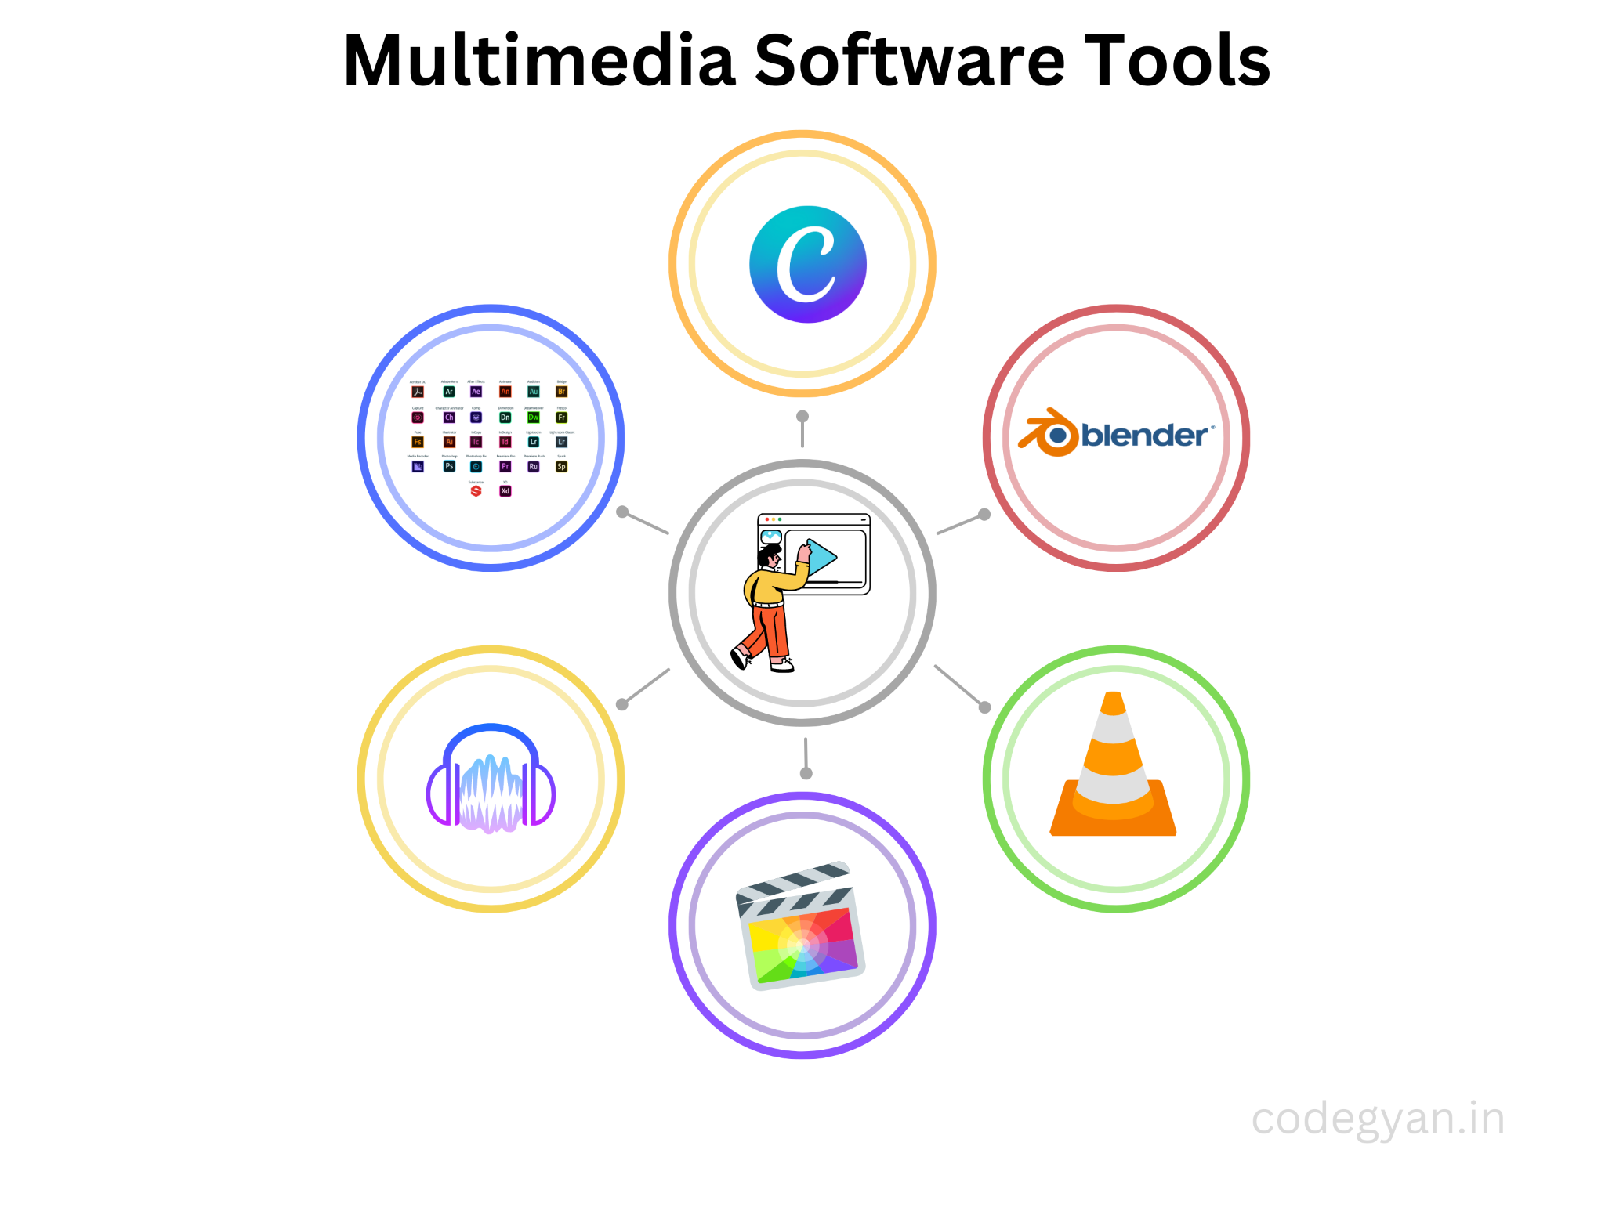
Creating accessible content: 3 Strategies for inclusivity
3. Enhance engagement with multimedia
Incorporate multimedia elements:
Utilize videos, podcasts, and audio clips alongside written content to enhance accessibility and engagement. The multimedia elements can be a great way to engage people and to make complex concepts more understandable. However, it is important to make sure that all multimedia elements are accessible to all people. This may involve providing alternative text for images, captions and transcripts for videos, and audio descriptions for complex images and videos.
Use Text to Speech Integrations
Implement text-to-speech (TTS) technology on your website, allowing visually impaired visitors to have the content read aloud, enhancing accessibility.

Slide 47
Case Studies in Inclusive Online Learning
Case Study 1: "Inclusive Online Learning Environment for Support Services"
Background: A collaborative effort between social care organizations aimed to establish an inclusive online learning environment focused on support services offered to their beneficiaries with disabilities. Social care specialists from different backgrounds and expertise areas were brought together to develop a comprehensive accessible curriculum.
Strategies Implemented:
Collaborative Curriculum Development:
Approach: Social care specialists collaborated on designing the curriculum, ensuring a holistic approach to disability support services. The curriculum incorporated a blend of text-based materials, audio lectures, and video demonstrations.
Outcome: The collaborative curriculum development approach led to a well-rounded course structure, addressing different learning preferences and abilities.

Slide 48
Case Studies in Inclusive Online Learning
Case Study 1: "Inclusive Online Learning Environment for Support Services"
Accessible Multimedia Integration:
Approach: Multimedia elements, such as images, videos, and audio clips, were integrated with accessibility features like alternative text and captions. Specialists were trained to create engaging multimedia content adhering to accessibility standards.
Outcome: Participants with visual or auditory impairments could engage seamlessly with the multimedia content, enhancing their learning experience within the online courses.
User-Friendly Interface Design:
Approach: Emphasis was placed on designing a user-friendly interface, incorporating easy navigation, clear instructions, and intuitive layouts. Social care specialists were guided on creating online courses with user experience in mind.
Outcome: The user-friendly interface ensured that individuals with cognitive disabilities could navigate the online platform independently, promoting a sense of empowerment and inclusivity.
Impact: The collaborative efforts of social care specialists resulted in the development of an inclusive online learning environment for disability support services. The courses created through this initiative became accessible hubs of knowledge, fostering an inclusive educational experience for individuals with disabilities, thereby promoting social inclusion and understanding within the society.

Slide 49
Case Studies in Inclusive Online Learning
Case Study 2: "Challenges in Inclusive Online Learning"
Background: A social care organization launched an online training program for caregivers and social workers aimed at supporting individuals with disabilities. However, the initial approach did not prioritize inclusivity, leading to challenges for learners with disabilities.
Initial Approach:
Limited Accessibility Features:
Issue: The online platform lacked essential accessibility features such as screen reader compatibility, subtitles, and alternative text for images and multimedia elements.
Impact: Learners with visual or hearing impairments found it difficult to access and engage with the course content, leading to exclusion from the learning experience.
Complex Navigation and Design:
Issue: The course platform had a cluttered interface with complicated navigation, making it challenging for learners with cognitive disabilities to follow the course structure.
Impact: Learners struggled to find relevant materials and progress through the modules, causing frustration and hindering the learning process.

Slide 50
Case Studies in Inclusive Online Learning
Case Study 2: "Challenges in Inclusive Online Learning"
Lack of Sensitivity Training:
Issue: Caregivers and social workers were not provided with sensitivity training regarding interacting with individuals with diverse disabilities.
Impact: Inadequate understanding led to unintentional insensitivity, creating discomfort for learners with disabilities and hindering effective communication and support.
Outcome: The initial training program faced significant criticism due to its lack of inclusivity. Learners with disabilities expressed frustration and dissatisfaction, highlighting the program's failure to meet their unique learning needs. The overall impact was a negative learning experience for a significant portion of the audience, contrary to the program's intended goal of providing support and education.

Slide 51
05
Tailoring Verbal and Content Communication Techniques for Online Learners with Disabilities
Definition, importance and communication process

Slide 52
Tailoring Verbal and Content Communication Techniques for Online Learners with Disabilities:
Social workers can create a more inclusive online learning experience for people with disabilities by adapting their verbal and content communication techniques based on the specific needs of the audience. Here are some communication strategies to be used:
Visual Impairments:
Content: Use alt text descriptions for images and videos to convey information visually impaired learners cannot see. Employ descriptive language that paints a clear picture.
Verbal: Avoid relying heavily on visual aids during lectures. Describe visuals in detail, including color, size, and location.
Hearing Impairments:
Content: Provide transcripts for all audio content including lectures, videos, and podcasts. Ensure transcripts are accurate and well-formatted.
Verbal: Speak clearly and at a moderate pace. Consider using assistive technologies like closed captioning for synchronous sessions.

Slide 53
Tailoring Verbal and Content Communication Techniques for Online Learners with Disabilities:
Learning Disabilities:
Content: Break down information into smaller, manageable chunks. Use clear headings, subheadings, and bullet points to improve organization. Offer multiple formats like text and audio versions of content.
Verbal: Provide clear and concise explanations. Avoid jargon and complex sentence structures. Reiterate key points throughout the course.
Mobility Impairments:
Content: Ensure the online platform is accessible with keyboard navigation. Use large fonts and high color contrast for text readability.
Verbal: No specific adaptations needed, but be mindful of time constraints if learners require additional time to complete tasks.
Cognitive Impairments:
Content: Simplify and condense complex information. Use concrete examples and real-world applications to illustrate concepts. Offer interactive exercises and practice activities to reinforce learning.
Verbal: Speak slowly and clearly. Provide clear instructions and explanations. Allow ample time for learners to process information and respond to questions.

Slide 54
Tailoring Verbal and Content Communication Techniques for Online Learners with Disabilities:
General Techniques:
Self-Paced Learning: Provide opportunities for self-paced learning to accommodate individual learning styles and pace. This allows learners with disabilities to review material repeatedly if needed.
Flexibility: Offer different assessment methods to cater to diverse learners. Consider using a variety of assignments like essays, presentations, and practical projects.
Assistive Technologies: Encourage learners to explore the use of assistive technologies available on the platform, such as text-to-speech tools and screen readers.
By incorporating these techniques, social workers can create online courses that are more accessible and engaging for learners with a wide range of disabilities.
Remember:
Always prioritize clear communication and a welcoming environment.
Be open to feedback from learners and make adjustments to the course as needed.
These strategies will empower you to create online learning experiences that truly enhance the lives of people with disabilities.

Slide 55
Tailoring Verbal and Content Communication Techniques for Online Learners with Disabilities:
Accessible written and visual content creation - general rules:
Use manageable sections of text: use short sentences that are not unnecessarily complex.
Learn about accessible font styles.
Descriptive hyperlinks: Use hyperlinks to describe the content they link to and the destination.
Use headings (created using the styles tool) to structure your document.
Add alternative text to images.
Avoid using SmartArt.
Avoid adding text boxes.
Avoid putting important information in the header or footer.

Slide 56
Tips for Effective Online Communication
Here are some examples of synchronous sessions that you could offer:
Introduction session: In the first week of class, hold a synchronous session to introduce yourself and answer people' questions about the course.
Course wrap-up session: At the end of the class, hold a synchronous session to address people' questions and concerns about final projects or exams.
Deep dive sessions: If people are particularly interested in a particular topic, you could hold a deep dive session to elaborate on that topic.
Pinch point sessions: If people are struggling with a particular topic, you could hold a pinch point session to help clarify it.
Guest speaker sessions: Bring in a guest speaker to talk about best practices in the field or share their professional experience.
Office hours: Make yourself available at a recurring time each week so that people can drop in to ask questions.

Slide 57
06
Conclusion
Definition, importance and communication process

Slide 58
Conclusion
This lesson has equipped you with essential knowledge and skills for successfully communicating in different online settings with people with disabilities.
You've explored the concept of online communication, learned about verbal and non-verbal cues in the online environment, and discovered techniques to enhance your communication and overcome the physical and social barriers. We've also emphasized the importance of creating accessible content and tailoring your communication style for inclusivity.

Slide 59
Conclusion
Takeaways:
Inclusivity is foundational: Online communication isn't just transmission; it's about creating an environment where learners with complex needs can thrive.
Transformational power: Clear and expressive language, visuals, using a mix of synchronous and asynchronous interactions, and encouragement transform participation and comprehension.
Building a community: Educators aim at creating and growing an inclusive online community valuing every voice.

Slide 60
07
Useful links
Definition, importance and communication process

Slide 61
Useful links
World Wide Web Consortium (W3C) Web Accessibility Initiative (WAI): W3C WAI offers comprehensive guidelines and resources aimed at making web content accessible to people with disabilities. Their materials provide in-depth insights into web accessibility standards.
Disability Rights Education & Defense Fund (DREDF): DREDF provides a wealth of resources covering disability and communication. Their guides include valuable information on accessible online learning, making it a vital resource for understanding inclusivity in digital education.
National Center for Accessible Media (NCAM): NCAM offers resources focused on accessible educational materials. Their guide on creating accessible videos is particularly useful for educators aiming to enhance their multimedia content's inclusivity.

Slide 62
Useful links
CAST: Universal Design for Learning: CAST is a pioneer in Universal Design for Learning (UDL). Their website provides extensive resources, research articles, and practical tools to implement UDL principles, ensuring inclusive education for all.
WebAIM: Web Accessibility in Mind: WebAIM is a leading authority on web accessibility. Their website offers a plethora of articles, tutorials, and evaluation tools aimed at making web content accessible. It's a valuable resource for understanding the technical aspects of digital accessibility.
Center on Online Learning and people with Disabilities: This center focuses specifically on online learning and people with disabilities. Their resources delve into various aspects of online education, providing insights into creating accessible online courses.

Slide 63
Thank you for your attention!
Project no: 2022-1-RO01-KA220-VET-000085029

