Slide 1
Teach me to help
MODULE II Lesson 4
Online verbal communication techniques -
the importance of words and how they can influence perception
Project no: 2022-1-RO01-KA220-VET-000085029

Slide 2
Lesson structure
Online verbal communication techniques - the importance of words and how they can influence perception
General notions about verbal communication. The role of speech
Use of disability-inclusive language
Fundamentals of inclusive verbal communication
The importance of words and how terms can influence perception
The power of speech and its properties in influencing behaviour
Language techniques that make verbal communication difficult or NOT
Language techniques that make verbal communication effective or So Yes
Conclusions

Slide 3
Objectives
At the end of the lesson, learners will be able to:
recognise general notions about verbal communication;
show the role and properties of the word;
use language that is inclusive of people with disabilities;
practice principles of inclusive verbal communication;
choose appropriate words in communicating with people with special needs;
exemplify verbal techniques that make communication difficult (so NO),
exemplify verbal techniques that make communication more effective (so YES);
review notions of communication theory to improve their own communication;
become aware of communicative situations in which we use the properties of the word;
update favourable and unfavourable techniques useful in the communication process.

Slide 4
01
The role of words in the influence process

Slide 5
1. The role of words in the influence process
The term "verbal" - lat. "verbum" = word and speech, communication with words = "verbal communication".
The word in vocal or audible form = oral or spoken, and in graphic, visual expression = written. The distinction is made by the channel of communication: auditory for oral communication and visual for written communication.
Verbal communication is the exclusive prerogative of man, the only living creature capable of communicating thoughts and feelings using words in the form of vocal or graphic signs.
Each language is made up of 28 to 35 phonemes, which graphically and sonically make up an alphabet. These make up words and are delimited by pauses in oral communication or by spaces in written communication.

Slide 6
1. The role of words in the influence process
Prutianu (2004): 'the essence of verbal language lies in its symbolic character based on purely conventional correspondences between the word sign (the cat for example) and the object it signifies (the meow-meow animal)'.
The meaning is not contained in the word, but in the mind of the recipient.
Words are codes, not sound signals or graphic signs with meaning in themselves. Even the definitions given to words in dictionaries remain dead letters if they are not decoded by readers.
Tran and Stănciugelu (2010) define communication as a "fundamental mode of psychosocial interaction of people, carried out in articulated language or other codes, in order to convey information, achieve stability or bring about changes in individual or group behaviour."

Slide 7
Communication peculiarities:
relationships are established between people in the same environment. Distinctly, online communication can also continue face-to-face, just as face-to-face communication can cross online;
it aims to achieve objectives and convey meaning through the composition of the message conveyed;
the three dimensions of all communication: outward (observable through verbal and non-verbal behaviour), metacommunication (what is understood beyond words) and intracommunication (the exchange of information that takes place at the level of the inner self);
the imprint of the space in which it takes place, conveying the characteristics of that environment. In particular, online communication makes use of the specific characteristics of the digital environment;
the message, the people and the relationships established are dynamic, once this process is initiated, it generates evolution and change, sometimes irreversible.

Slide 8
Speaking clearly and listening carefully become the two mutual goals for communicating effectively online and face-to-face. (Dale King, 2020)
Borțun (2001) outlines the main purposes of communication:
to be received: seen, heard, read;
to be understood (the transmitted message to be decoded correctly);
to be accepted (message sent not to be rejected;
to provoke a reaction (the message conveyed to bring about a change in perception, thinking, interpretation or behavioural attitude).
The psychology of communication highlights a number of other goals that people pursue when communicating, linked to the fulfilment of specific human needs, the need for prestige, the confirmation of social status, the banishment of loneliness.

Slide 9
Digital communication and collaboration:
interacting through digital technology;
sharing materials or information through digital technologies;
citizen participation through digital technology;
digitally mediated collaboration;
Netiquette - ethical behaviour online;
digital identity management. (E.C., 2016),
Language is the most complex language because it can perform all the specific functions: cognitive, communicative, representational, expressive, persuasive, regulatory, ludic and dialectical.

Slide 10
Digital communication etiquette (Netiquete) refers to:
1. Establish clear communication guidelines
2. Respecting others' time and attention
3. Promoting a positive and inclusive environment
4. Managing conflict with diplomacy and respect
5. Understanding and respecting privacy and boundaries

Slide 11
Application 1
Motto: "Every word is an attempt to influence the other." (Alex Mucchielli)
An induction word is given (examples: communication, love...).
Each participant in the meeting makes a list of 10 induced words that occur in the mind after the given inducer word, associated with the images and sensations suggested by it.
Compare the lists of induced words, marking first the words that are repeated twice, then three times, and so on depending on the context of the activity.
Interpret and comment on the results of the game.
It can be seen that one word evokes different individual experiences, even if they are signified by the same word.
Note: the application can be done both in the traditional face-to-face format and online. In a digital context, collaborative lists from apps can be used

Slide 12
02
Inclusion and divisiveness through language. UN recommendations

Slide 13
2. Inclusion and divisiveness through language
Political correctness and inclusive language share the goal of using a certain, sometimes neutral, terminology to mitigate prejudice and stereotypes. However, their application has proven divisive. While some segments of society enthusiastically embrace these linguistic shifts, others resist, leading to a cultural and social polarization often termed the "culture wars."

Slide 14
2. UN recommendations for a disability- inclusive language
The UN Office has developed recommendations to support the implementation of the Disability Inclusion Strategy, introduced in 2019.
The aim is to remove barriers and involve people with disabilities in all aspects of work and life to achieve progress in their inclusion.
An important aspect of the strategy is compliance with the communication standard, which requires internal and external communications to demonstrate respect for people with disabilities.
It provides guidelines for improving verbal and written communication about disability, covering various forms of communication from speeches and presentations to press releases and social media posts.

Slide 15
The right choice of words is crucial in communicating with people with disabilities as terminology can influence how they are perceived. Using inappropriate language can lead to exclusion or offence, affecting their participation and human rights.
The use of inclusive language is essential in the fight against discrimination and prejudice against people with disabilities.
According to the UN Convention on the Rights of Persons with Disabilities, it is essential to adhere to appropriate language and terminology; precise guidelines are given for the correct understanding and use of this language.
The main purpose of these guidelines is to promote the uniform use of appropriate language within the UN. They provide a table of preferred and non-preferred terms, together with examples for clarification, to ensure compliance with established terminology standards.

Slide 16
03
Guidelines for using a disability- inclusive language

Slide 17
3. Guidelines for using a disability-inclusive language
Use language that prioritises people above their illnesses or disabilities.
Person-based language is the most commonly recognised form of communication for people with disabilities because it puts the focus on the person or group before the disability. However, not all categories of disability are universally prioritised and it is important to ask about the preferred way of identifying people with disabilities.
As an illustration, we can use expressions such as "people with albinism", "pupils with dyslexia", "female people with intellectual disabilities" and, of course, "people with disabilities".

Slide 18
3. Guidelines for using a disability-inclusive language
2. Avoid using categorisations and generalisations.
Disability is an inherent aspect of human existence and should not be exaggerated or sensationalized. People with disabilities should not be portrayed as inspirational or as having extraordinary abilities. Refusal to refer to them as "brave" or "outdated" is patronising.
The term "survivor" is sometimes used to describe those who have successfully adapted to a medical condition, but some find the rhetoric of war inappropriate and unpleasant.

Slide 19
3. Guidelines for using a disability-inclusive language
3. Avoid using condescending euphemisms
The use of euphemisms such as 'people with different abilities' and 'people of all abilities' can be seen as patronising or disrespectful, as they deny impairments.
The term "disabled" is considered more neutral than "handicapped" and the term "special" is often criticised for stigmatising differences between people with disabilities. Instead, neutral or positive language, such as 'adapted assistance', should be used. The term 'special education' is often associated with negative implications and should be avoided

Slide 20
3. Guidelines for using a disability-inclusive language
4. Disability is neither a medical condition nor a challenge.
The medical model of disability sees disability as a health condition to be corrected, while the charitable model sees it as a burden to be solved.
This approach maintains unfavourable stereotypes and unfair labelling. People with disabilities should not be labelled as patients unless they are receiving medical treatment. Instead, they should be referred to as a 'person with dyslexia' or a 'person who has dyslexia'. People-centred terminology should be used and phrases such as "a person has [a disability]" or "a person is [blind/deaf/blind]" may be used. The term "victim" should only be used when directly applicable.

Slide 21
3. Guidelines for using a disability-inclusive language
5. Use appropriate language in verbal and casual speech.
Most people with disabilities can easily cope with vocabulary commonly used in everyday situations. To include a person who uses a wheelchair, you can suggest "let's go for a walk". Similarly, to communicate with someone who is deaf, you can ask "have you heard the news?". However, expressions such as "blind as a bat" or "deaf as a post" are inappropriate and should be avoided, even in casual situations.
Incorrect use of terms can also be inappropriate and offensive, so refrain from stating "I think I have Alzheimer's" when you forget something or "they're paranoid" when others seem to act with extreme distrust. Avoid using disability-related terminology as an offensive or critical phrase. Avoid using the term "lame" as a substitute for "boring" or "uncool".

Slide 22
04
Importance of words and how terms can influence perception

Slide 23
4. Importance of words and how terms can influence perception
Avoid passive, victim words. Use language that respects disabled people as active individuals with control over their own lives.
Language that includes and takes into account people with disabilities:
Appropriate terms | Inappropriate terms
disabled person person with [type of disability] people with disabilities | (the) handicapped, (the) disabled, person with special needs, atypical, atypical person, person with different abilities
person without disabilities; rest of the population | normal, healthy, able, typical, whole, whole to body; healthy in body/mind
has [name of condition or impairment] | afflicted by, suffers from, victim of
disabled person | cripple, invalid

Slide 24
Language that includes and takes into account people with disabilities:
Appropriate terms | Inappropriate terms
person with intellectual disabilities person with an intellectual disability | retarded, simple, slow, slowly, affected, brain- impaired, intellectually challenged, subnormal, feeble-minded, feeble-minded, feeble-minded, handicapped
person with psychosocial disability | crazy, manic, psychopathic, hypersensitive, lunatic, insane, panic, agitated, mental deranged, mentally ill
deaf person person who is deaf hearing impaired person hearing-impaired person deaf person hearing-impaired person deafblind person | deaf, hard of hearing, deaf and dumb, deaf-mute

Slide 25
Language that includes and takes into account people with disabilities:
Appropriate terms | Inappropriate terms
deaf person person who is deaf hearing impaired person deafblind person | deaf, hard of hearing, deaf and dumb, deaf-mute
people with visual impairments blind people blind and partially sighted people | the blind
physically disabled person person with a physical disability | infirm, disabled, deformed, lame, handicapped, physically handicapped, physically challenged person limitations
wheelchair user person using a wheelchair person with mobility impairment person with reduced mobility person using a mobility device | immobilised in a wheelchair wheelchair-bound

Slide 26
Language that includes and takes into account people with disabilities:
Appropriate terms | Inappropriate terms
short person, small person someone with restricted growth or short stature person with achondroplasia (only if the person has this condition) | dwarf, midget
person with Down syndrome person with trisomy-21 | mongoloid, special person, Down
person with albinism | albino
person affected by leprosy | leper
person using a communication device, person using an alternative method of communication | mute, unable to speak, non-verbal
accessible parking parking reserved for the disabled accessible bathroom | disabled parking bathroom for disabled people

Slide 27
Terms requiring further linguistic clarification
1. The distinction between ACCESS and ACCESSIBILITY
Access refers to the opportunity or right to participate in a particular activity or to enter a particular place. Having a United Nations badge allows you to enter the UN premises
Accessibility is the intentional design of goods, technologies, services or places to ensure that they can be easily used by people, whether or not they have disabilities. It includes the provision of accessible information and communication. Physical accessibility refers to the creation of a barrier-free environment that enables people with disabilities to move about without restriction.
Although access may be granted, it does not necessarily guarantee accessibility. It is therefore important to use these expressions appropriately and in the correct context

Slide 28
Terms requiring further linguistic clarification
2. Braille
Braille is not considered a language, but rather a tactile writing system used by blind or visually impaired people to read and write. Braille is a tactile system consisting of raised dots that can be seen tactilely, used by people with impaired or limited vision. Not all visually impaired people are able to understand and interpret Braille. People who are able to read and write using Braille can be identified as Braille users. It is important to note that the ability to read Braille is not exclusive to blind people.
Therefore, one should avoid making assumptions about a person's visual impairment solely on the basis of their ability to read Braille. The act of transforming written text into Braille is referred to as 'transcription' rather than 'translation'. The technique of creating an embossed design on a surface is known as embossing.

Slide 29
Terms requiring further linguistic clarification
3. The distinction between subtitling and transcription
Subtitles and transcripts may be displayed as text at the bottom of the screen and represent speech, but they are not the same thing.
Transcripts are particularly beneficial for the hearing impaired as they provide details of background sounds, speaker identification, music description and other pertinent information.
Subtitles are designed for viewers who can hear but cannot understand the language spoken in the video, such as in foreign language films. They provide speech only.
There are two types of subtitles: open subtitles and closed subtitles. The viewer has the option to disable closed captions, but open captions are permanently included in the film and cannot be disabled. Accessible meetings include live transcripts, which can be provided either remotely or on location. It is important to consider all these distinctions when using these phrases.

Slide 30
Terms requiring further linguistic clarification
4. Community of the deaf
The phrase "I'm deaf" is frequently used by those who pride themselves on being part of the "deaf community". They perceive themselves as a distinct cultural and linguistic minority, using sign language as the predominant means of communication and possessing comparable principles.
However, United Nations’ practice is not to capitalize the terms "deaf" or "deaf community".

Slide 31
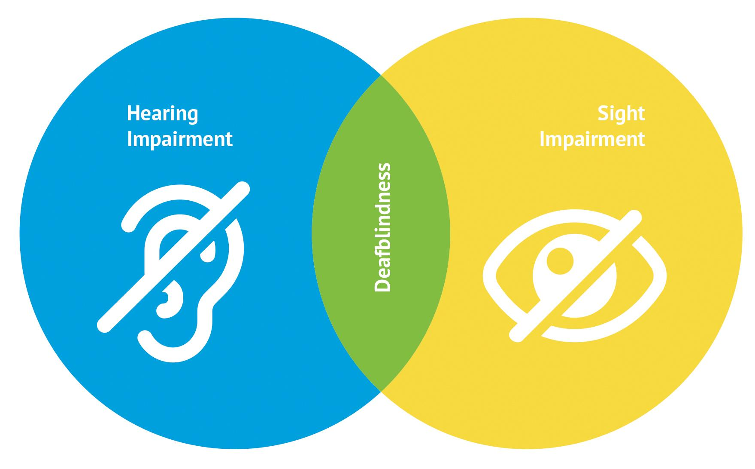
Terms requiring further linguistic clarification
5. People who have both hearing and sight impairments.
People with deafblindness represent a diverse group of people who experience substantial sensory impairments, including both blindness and deafness.
At the United Nations, the term "deafblindness" is preferred.

Slide 32
Terms requiring further linguistic clarification
6. Statement and vision
People with disabilities have the right to choose whether or not to disclose information about their disability status. In the workplace, it is advisable to refrain from using the conventional phrases "disclosing" or "declaring" the disability, as these may imply that the person is disclosing a confidential matter.
Avoid using the phrase "identification as a person with a disability" as this creates concerns about identity and inclusion. It is possible for a person to have a physical or mental limitation, but not to consider themselves a person with a disability. The phrase 'choose to share information about their disability/disability' accurately describes the decision people make to disclose their disability or specific needs to their employer or co-workers.

Slide 33
Terms requiring further linguistic clarification
7. Disabled person
The term "disabled person" is favoured in some nations. The phrase in question should be retained when discussing their laws, policies or entities, as it accurately represents the situation in the nation or the conscious decision of the author. If deemed essential, quotation marks may be used as appropriate. It is advisable to use "people-first" language on United Nations websites, documents and speeches, referring specifically to people as "persons with disabilities".

Slide 34
Terms requiring further linguistic clarification
8. Simplified readability
Easy Read is a format designed specifically for people with intellectual disabilities or those who have difficulty understanding written information.
The act of creating an Easy Read version of a regular publication is called "adaptation" rather than translation. However, like any other written material, Easy Read composed in one language has the ability to be converted into any alternative language, resulting in what we call translation.
For example, the statement "The United Nations Chronicle is an easy-to-read quarterly report on the work of the United Nations and its agencies" does not indicate that the Chronicle is specifically provided in an easily accessible format, it means that the report is written in a simple and understandable way.

Slide 35
Terms requiring further linguistic clarification
9. Help, support, assistance
The terms 'help', 'support' and 'assistance' have distinct meanings and are not interchangeable. The use of 'help' is discouraged because it conveys the perception that people with disabilities lack autonomy and rely on others.
"Support" and "assistance" are more empowering and appropriate terminology and can be used in phrases such as "participants in need of assistance" or "disability support measures".

Slide 36
Terms requiring further linguistic clarification
10. The distinction between impairment and disability
According to the World Health Organization, impairment is defined as any deviation or abnormality in psychological, physiological or anatomical structure or function. Disability, on the other hand, results from the interaction between persons with impairments and barriers imposed by attitudes and environmental factors, which prevent their full and equal participation in society, as stated in the preamble to the Convention on the Rights of Persons with Disabilities, under (e). Because of their distinct definitions, these words cannot be substituted for each other.

Slide 37
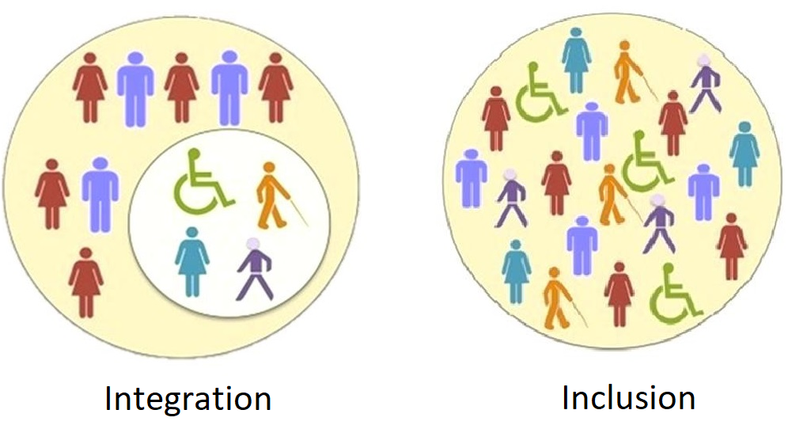
Terms requiring further linguistic clarification
11. Comparing integration and inclusion
Integration and inclusion are very distinct from each other. Integration is the act of helping an individual to adapt and conform to society, while inclusion involves changing society to ensure that everyone, regardless of disability status, is included.
When discussing people with disabilities, the implications of 'inclusion' are favourable, but those of 'integration' are unfavourable. Consequently, the two terms cannot be used interchangeably.

Slide 38
Terms requiring further linguistic clarification
12. Distinctions between needs and requirements
Some United Nations agencies and experts have expressed a preference for using the term "requirements" instead of "needs".
This aligns with the human rights perspective on disability, in which we recognise that people with disabilities possess inherent rights. The phrase 'needs' is often associated with the misconception that people with disabilities are dependent or burdensome, particularly when referring to their 'care needs'. An example that exemplifies this methodology is the fact that educational institutions are obliged to provide Braille materials to visually impaired students, not because of their need, but because they are entitled to receive a high standard of education just like their peers.

Slide 39
Terms requiring further linguistic clarification
13. Disability rights organisations
Organisations made up of people with disabilities should be distinguished from organisations that exist for the purpose of assisting people with disabilities.
Organisations that include people with disabilities are run and managed by people with disabilities themselves. They advocate for the legal rights and interests of their members.
Instead, organisations dedicated to people with disabilities provide services and advocate for their rights, but are not run or managed by people with disabilities.

Slide 40
Terms requiring further linguistic clarification
14. PWD stands for people with disabilities.
The use of the acronym "PWD" or "pwd" (Person With Disabilities) to refer to persons with disabilities is not appropriate in official United Nations documents.

Slide 41
Terms requiring further linguistic clarification
15. Simplified language
Plain language refers to communication that is easy for the audience to understand at first reading or hearing. Simplistic language and technical terms are omitted and some other guidelines are followed, including the use of concise sentences and refraining from the use of the passive voice. It may alternatively be referred to as plain English, simple writing or straightforward writing. However, the situation is very pertinent. For example, if you specify that a document will be "available in plain English", it could be interpreted as being exclusively in English, not including other languages. If this is not the case, it would be more desirable to use "plain language".

Slide 42
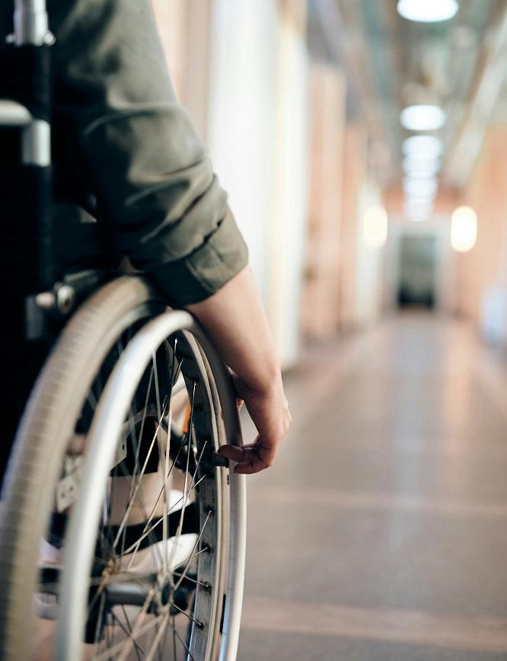
Terms requiring further linguistic clarification
16. Provision of reasonable accommodation
In the context of disability, the term 'accommodation', sometimes used in the phrase 'reasonable accommodation', refers to essential and appropriate modifications and adaptations made to ensure that people with disabilities can fully exercise their human rights and fundamental freedoms.
To avoid any confusion, other terms such as dwelling, accommodation, place of residence or living arrangements may also be used when talking about a place of habitation or residence. However, the term 'accommodation' can be used if there is no ambiguity.

Slide 43
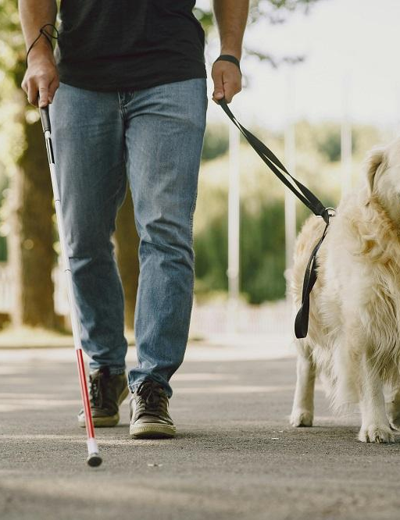
Terms requiring further linguistic clarification
17. Animals trained to help people with disabilities.
Service animals are taught to perform specific activities for people with disabilities. This may include animals that serve as guides for the visually impaired, animals that help to pull wheelchairs or animals that retrieve dropped items. Occasionally, the term "animal" is preferred to "dog" to incorporate other categories of animals that provide comparable services. For example, capuchin monkeys have been trained to help people with physical disabilities carry out their daily activities. Other creatures that can be trained or used to provide comfort are parrots, ferrets and horses.

Slide 44
Terms requiring further linguistic clarification
18. Study of sign language and international sign language
Sign languages from different regions have unique characteristics and are not mutually intelligible. Mexican sign language and Lithuanian sign language are just a few examples of sign languages. Some countries, such as Canada, have many sign languages. When discussing these particular languages, it is necessary to capitalise every word in their names.
Although there is no international sign language, there is a type of communication known as international sign language. International sign is a standardised system of signs that is used when deaf people from different countries get together on different occasions. Thus, we say that the United Nations provides interpretation of international signs, refraining from labelling them as a separate language.

Slide 45
Terms requiring further linguistic clarification
19. Comparison between visual impairment and blindness
The term "visual impairment" or "vision impairment" covers a broad spectrum of vision conditions of which blindness is only one, therefore these two terms are not synonymous.

Slide 46
Terms requiring further linguistic clarification
The power of the word is reflected in human behaviour through physiological reactions determined by the direct biochemical effects a word has on the human brain. (identifiable by the "lie detector")
In order to make a person perform a certain behaviour, we need to create a certain mood, the preferred psychological state for that action.
A word can make us laugh or cry unstoppably, make us dream or suffer.
Pragmatic mechanisms:
Labels: label words for our emotions, passions and feelings.
Images: words that directly signify a mental image.
Associations: spontaneous meanings in a person at the influence of a word.
Parallel information: information about the speaker through the words used.

Slide 47
Terms requiring further linguistic clarification
Words are not reality but only a symbolic expression whose meaning is attributed to the person. The same word can arouse different moods.
Denotation refers to the common meaning given to a word by members of a community, basically the dictionary definition.
In the movement of language we identify a series of correspondences that challenge the rigour of words:
synonyms: words that differ in form but have a similar or identical meaning (e.g. like/similar);
homonyms: words with the same graphic form but totally different meanings (e.g.: jolly/ jolly);
polysemy: the multiplicity of meanings that a word can have (e.g. the verb "to keep" which in Romanian has 45 meanings).
Connotation is the figurative meaning attributed to a word. The expression "a sharp mind" does not refer to a cognitive system bound by a sharp knife, but has the connotation of depth of thought

Slide 48
Application 2- Illustrative experiment (Prutianu, 2004)
A 2003 BBC study on false memories selectively activated under the covert influence of words contained in the structure of questions, suggested that participants view 24 images. Among the slides presented was a picture of two cars colliding. At the end, the subjects were asked questions in different ways.
Some have been asked how fast they think the cars that collided with each other were going? Others were asked how fast they thought the cars that crashed into each other were going.
Although the difference between the two questions consisted only in the replacement of the verb (bumped/mashed), the influence of this change resulted in the group that received the second question indicating on average a speed 45-50 km higher than the group of participants asked the first question. Furthermore, the second question caused some participants to recall details such as broken windscreen shards at the crash site, which were not really there

Slide 49
Transformational vocabulary refers to a new concept in communication related to the field of personal development.
It has been observed that in the vocabulary of languages words describing negative emotions are significantly higher than those expressing positive emotions, leading to predominantly negative thinking and feeling.
For example, in English there would be 2086 words expressing negative emotions and only 1051 expressing positive emotions, according to data provided by Anthony Robbins, the developer of this powerful tool.
These observations, as well as my long practice in developing courses on the transformations that can occur by changing vocabulary, are condensed by the words of A. Robbins (2001): "by simply changing your ordinary vocabulary - the words that permanently describe your emotions - you can instantly change the way you think, feel and live."

Slide 50
Application 3 - Using the appropriate words
a. Words of success vs. words of failure
Observe the speech of a successful person. You will notice that he or she chooses words that express positive emotions and experiences, avoiding negative ones altogether.
Make a list of three frequently used demotivating words. Try to find one softer degree of expression for each, then two and practise replacing them in your expression.
b. Negative words
Attention to language could be as meticulous in word choice as it is in choice of dress. Prutianu (2004) provides a list of less negative words than those commonly used:
- angry/ agitated; - satisfactory/ promising;
- stressed/ anxious; - jealous/ possessive;
- depressed/ conceited; - quarrelling/ controversy;
- disaster/ problem; - maddened/concerned.
Express a personal experience using first the first word, then the second word and notice the difference in perception.
c. Positive words
We are also used to using positive, conventional words to express our feelings and experiences. This is the case with the well-known "well" attributed to a very wide range of experiences. Similarly to negative expressions, Prutianu (2004) also provides a list of positive words of different levels:
- good/ extraordinary; - interesting/ lightning;
- extraordinary/ divine; - normal/ superb;
- determined/ unwavering; - loved/ adored etc.
Express a personal experience using first the first word, then the second word and note the difference in perception

Slide 51
6. Language techniques that make verbal communication difficult or NOT
George Orwell "If thought corrupts language, language can also corrupt thought."
Thinking in words, like the need to think in order to use and understand words, creates interdependencies between thinking and language.
The pitfalls of verbal thinking:
ambiguity
polarisation
generalization
logorrhea
secretomania
egocentrism
jargon
slang
abstraction
denial
adverse
upset
indecision
impossible
disarming
tolerant
lie
conditional.

Slide 52
Ambiguity refers to the use of word properties to create messages with multiple, unclear meanings.
For example, when we say "a dozen professionals" we can equally well understand the denotative meaning, 12 people, or the connotative meaning, unimportant, insignificant, ordinary people. We can also use the word "hound" to mean both a dog and a policeman, "goose" to mean a bird or a gullible girl, etc.
Polarization is the way of expressing ideas dichotomously, around the two magnetic poles: positive versus negative; good or bad, black or white - without shades of grey as common sense reveals ("Between black and white there are countless shades of grey.").
For example, if we say that Germans are serious or non-serious we exclude most of the category that does not belong to one or the other of these extremes. The tendency to dispute and enter into conflict immediately arises when communicating in polarised language. The solution would be to propose opposing versions of what we want, in the form of questions such as "Don't you think..." which might stir up the spirit of contradiction, the negative reaction that actually helps to achieve the goal.

Slide 53
Jargon is a language in which words are used for the purpose of professional communication. Often, jargon communication can seem pretentious, elevated, pompous, which is why it is sometimes used by people to express a false professional prestige.
To illustrate the jargon, Prutianu (2004) evokes a message from the communication of some railway workers: 'Mammoths in front... pick up. Behind we make 500 cwt a day and sabotage as much as we can on the abutment."-only railway workers could understand....
Slang is a more colourful, picturesque variety of jargon, used in more suburban environments, but also cultivated in other contexts.
Slang can be enjoyable, bringing a particularity to the language of young people, but it can block communication or exclude slang speakers in higher backgrounds. You wouldn't be able to communicate in a formal environment with colloquialisms: cool, lame, etc.

Slide 54
The tolerant "shouldn't" highlights those rules of conduct that we expose as unbreakable, but by expressing them in this formula we still let them run their course.
"I shouldn't drink..."-instead I keep doing it; "You shouldn't smoke...". In exchange for this tolerant expression, we can emphasise firm behaviour: "We should never steal/kill etc."
The liar "to be honest" shows yet another trapped expression that unhappily plays on the value of honesty. When we introduce an idea with the phrase "in order to be honest" we admit that up to that point we have not been honest, but since then we decide to be. Instead of emphasizing the message introduced, attention is directed to the person of the speaker, arousing suspicion, distrust, as if his sincerity is not indubitable.
The conditional "if" shows the formula needed to reach a goal: "If you will do this, then you will get that." The conditional and causal nature of "if" can be vague, even suggesting an inability to do the necessary action. But replacing "if" with "when" gives a strong temporal nuance, giving the speaker the strength to achieve, confident that they have the resources they need, and only need a little time.

Slide 55
7. Language techniques that make verbal communication effective or ”So YES”
Jones (2017) presents 23 magic words that tell us exactly what we need to have influence, impact and success in communication, based on the subconscious functions of our brain.
1. I'm not sure if this is for you, but...
2. Open-minded
3. What do you know about...?
4. How would you feel if?
5. Just imagine!
6. When would be a good time?
7. I guess you didn't get a chance to...
8. Simple exchanges
9. You have three options
10. Two types of people
11. I'm sure we're similar in this respect
12. If..., then
13. Don't worry
14. Most people...
15. The good news is...
16. What happens next
17. What makes you say that?
18. Before you decide...
19. If I can, will you do the same?
20. Reach
21. One more thing
22. A favor, please...
23. Just out of curiosity

Slide 56
1. I'm not sure if this is for you, but...
The author suggests using magic words to present an idea or product to anyone at any time without fear of rejection. The phrase "I'm not sure it's for you, but..." increases the listener's curiosity and encourages them to make a decision. This gentle approach ensures that the decision feels pressure-free , with internal autonomy, preventing people from avoiding the opportunity to pitch their idea or product. The magic of a conversation is delivered through the last three-letter word, "but". The word "but" negates everything that has gone before, making the listener feel like they might want to explore the topic.
For example, "I'm not sure it's for you, but..." can be used to encourage someone to look at the results of a product or service. This can be beneficial in daily routines and conversations.

Slide 57
2. Open-minded
Open-minded people are more likely to be perceived as such than closed-minded ones, which can lead to more favourable conversations. To draw people to your idea, use phrases like "How open-minded are you?" and follow it up with a scenario you want them to agree with.
This approach increases the chances of them agreeing with your idea by 90%. Everyone wants to be open-minded, so use these words effectively.

Slide 58
3. What do you know about...?
In conversations that quickly turn into debates because someone thinks they know best, it is essential to control the conversation by moving the other person's position from certainty to doubt. This can be done by challenging their opinion or by engaging in an argument. Overcoming the "I know best" mentality can be challenging, especially when trying to introduce new ideas or concepts.
To overcome the "I know best" mentality, question your knowledge of the other person's opinion. The goal is to turn the situation into one where the other person admits that their opinion is based on insufficient evidence, while saving face in the conversation. The power of asking "What do you know about..." can delicately threaten their knowledge base and force them to share the reference, often leading to the realization that their firm opinion was unfounded.

Slide 59
05
Conclusions

Slide 60
Conclusions
In this lesson:
a theoretical synthesis of general notions about verbal communication has been made, showing the role and properties of the word that give power in the process of influence in verbal communication;
numerous applications have been exhibited to illustrate and practice the concepts presented;
an inclusive communication guide was presented with examples of appropriate verbal terms in communication with and about people with disabilities
the particularities of etiquette in online communication were presented;
practical aspects have been dealt with in the last two sections by detailing and exemplifying verbal techniques that make communication difficult (so NO) and that make communication more effective (so YES).

Slide 61
Conclusions
The content presented:
is a guide to perfecting verbal communication, online or face-to-face, by reviewing some of the concepts of communication theory specific to any language;
provides a guide to effective and appropriate communication with and about people with disabilities;
useful in becoming aware of communication situations where we use the properties of the word in the communication process;
provides guidance on etiquette in online communication;
updates favourable and unfavourable techniques useful in the influence process targeted by any communication.

Slide 62
Bibliography
Borțun, Dumitru (2001) Semiotics. Language and communication. Bucharest: Comunicare.ro.
Borțun, Dumitru, Frunzaru, Valeriu, Petre, Dan, Stanciu, Ștefan. (2012). Communication: Module Initiation. Bucharest: Comunicare.ro.
King, Dale. (2020). EFFECTIVE COMMUNICATION SKILLS. The Nine-Keys Guidebook for Developing the Art of Persuasion through Public Speaking, Social Intelligence, Verbal Dexterity, Charisma, and Eloquence. Hamatea Publishing Studio.
Jones, Phil, M. (2017). Exactly what to say. The magic words for influence and impact. Hoboken. NJ
Tran, Vasile, Stănciugelu, Irina. (2010). Communication theory. Bucharest: Comunicare.ro.
Prutianu, Stefan. (2014) Communication skills training. Polirom. Iași.
Robbins, A. (2001) The power of the unbounded. Amalteea Bucharest.
2016. DigComp 2.0: The Digital Competence Framework for Citizens
UN Office at Geneva. Disability-Inclusive Language Guidelines.

Slide 63
Thank you for your attention!
Project no: 2022-1-RO01-KA220-VET-000085029

